Slide 1
Mental Health and Suicide rate impacts worldwide
By Group 4

Slide 2
Overview Of Our Project
In the last decade we’ve seen an increase in concern in the media about mental health. Is mental health a new problem or was it just not publicized like it is now? In our project we are looking to answer a few questions about suicide rate worldwide. Our data includes data from over 100 countries and includes various other relevant data point for example the sex of the people commiting suicide in each country. Our data spans from 1985 - 2016.
Questions to be answered:
1) Are younger generations more susceptible to mental health problems and suicide?
2) Which sex is committing suicide at a higher rate worldwide?
3) Which regions of the world are commuting suicide at a higher rate?
4) Does a country’s economy (GDP) affect suicide rates?
5) Over the years has suicides and bad mental health become a silent pandemic?

Slide 3
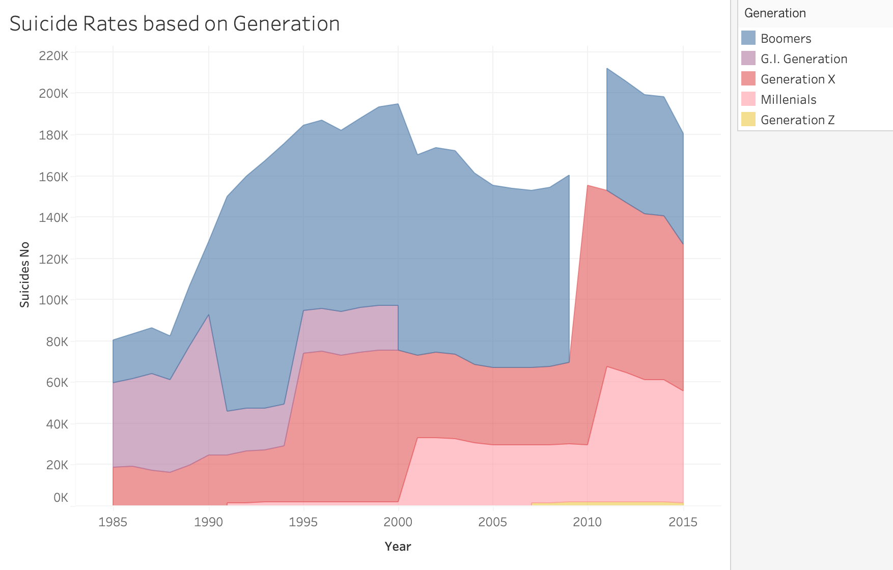
Are younger generations more susceptible to mental health problems and suicide?

Slide 5
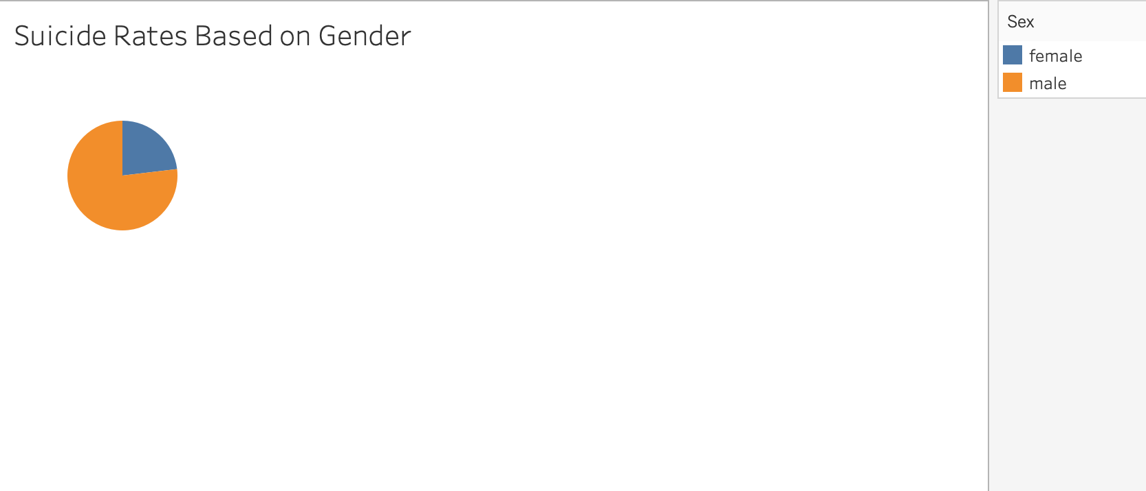
Which sex is committing suicide at a higher rate worldwide?

Slide 6
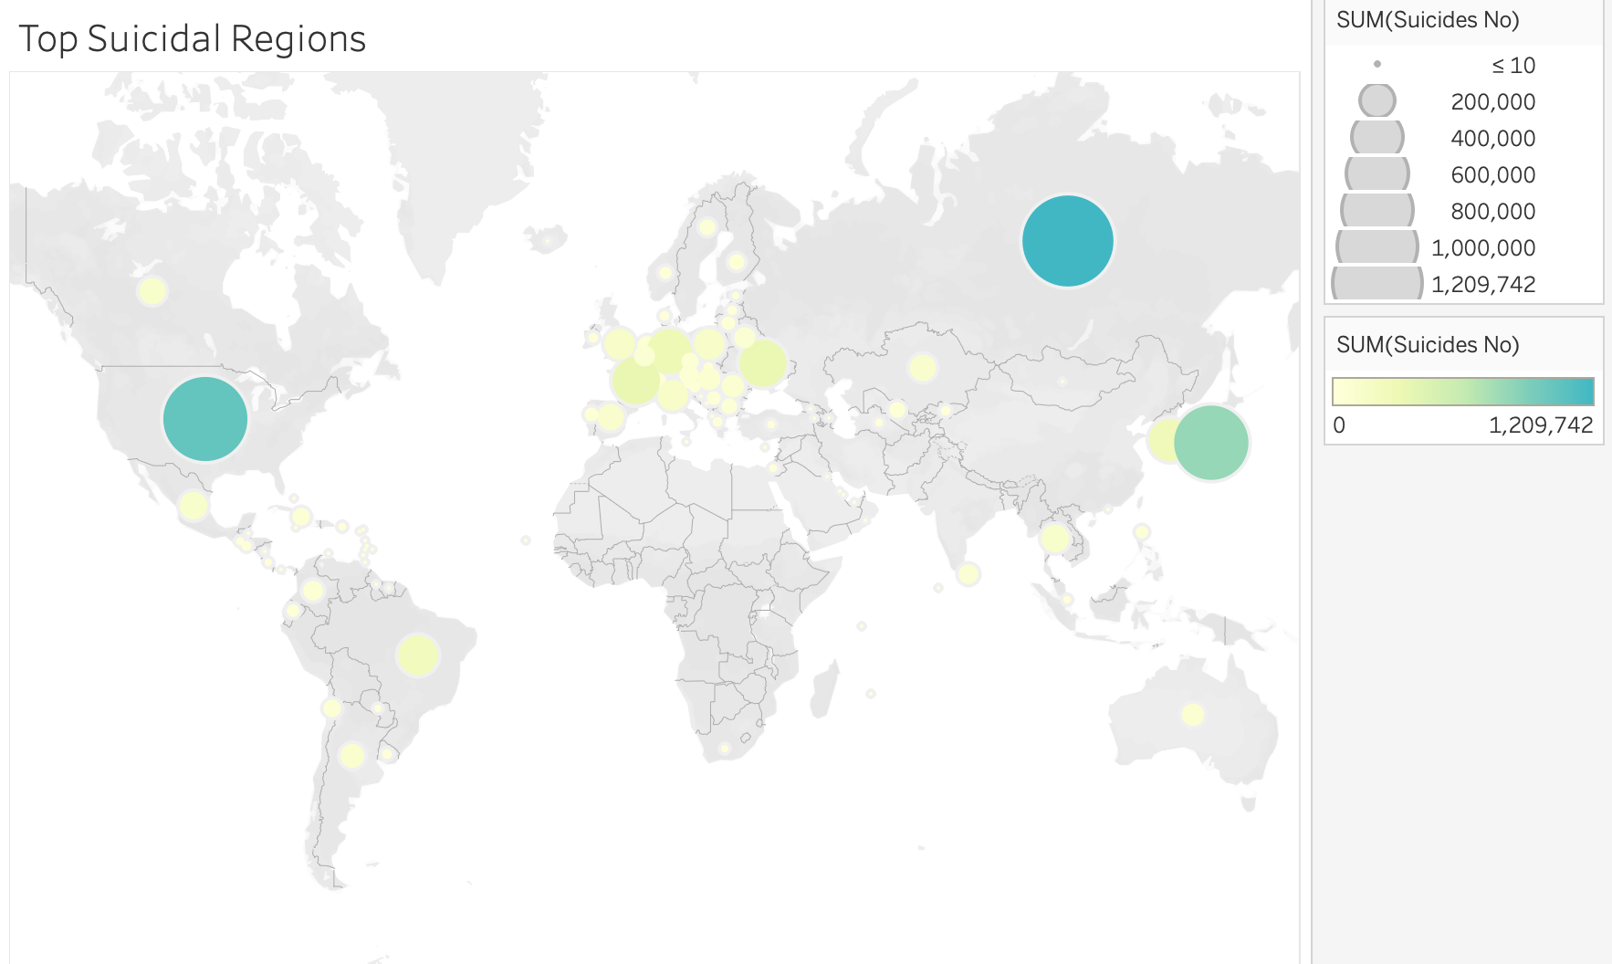
Which regions of the world are commuting suicide at a higher rate?

Slide 7
Does a country’s economy (GDP) affect suicide rates?

Slide 8
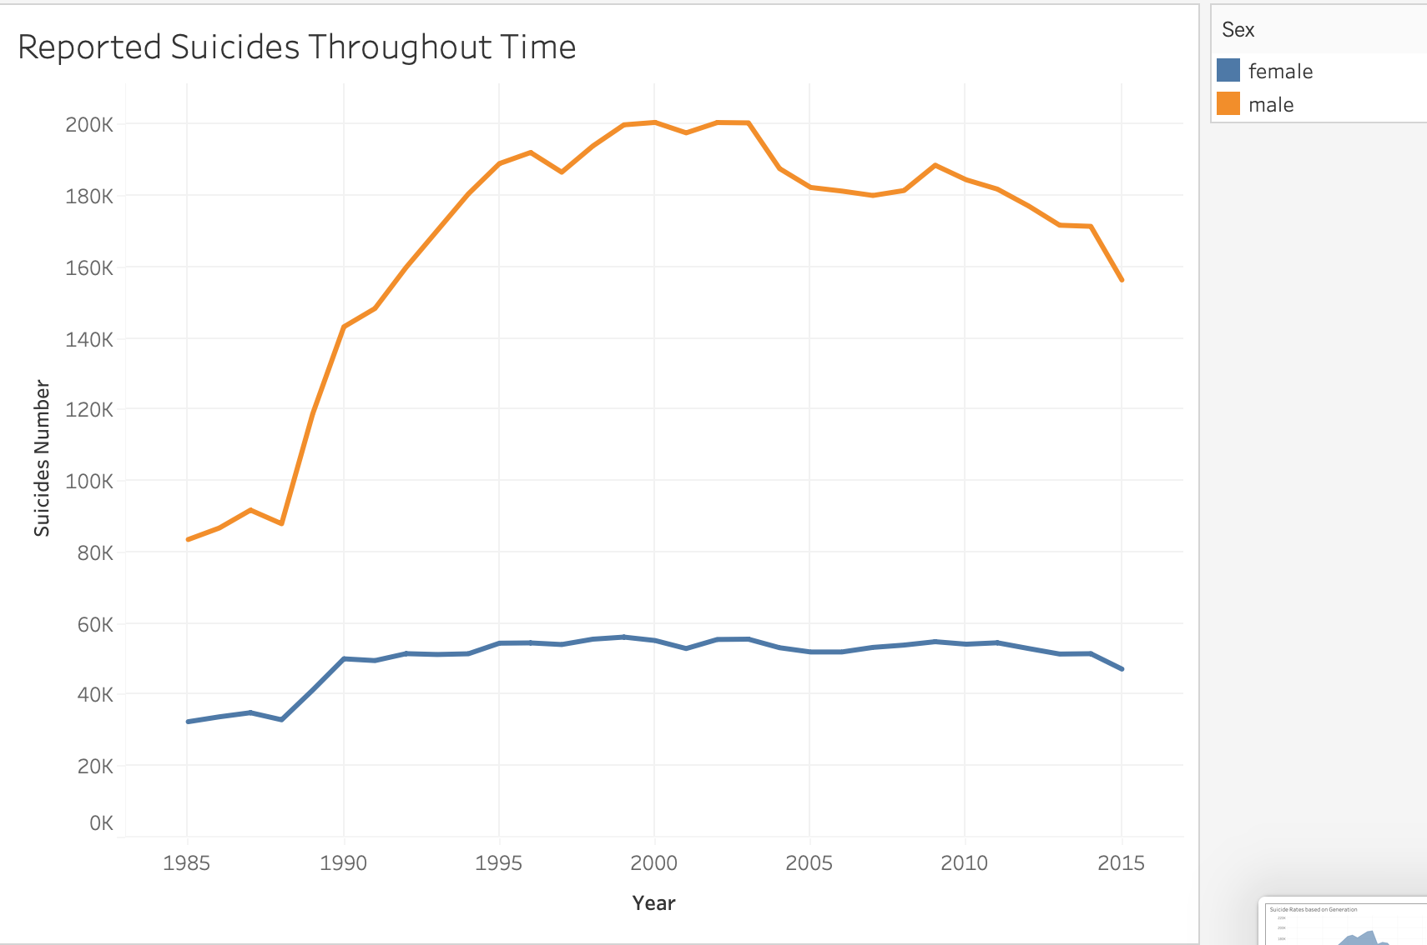
Over the years has suicides and bad mental health become a silent pandemic?

Slide 9
Description
The model we believed would fit best with our dataset is the Supervised Machine Learning Model.
A Supervised Model was best simply because we already have the labeled outcomes using the dataset we picked out (from 1985 - 2016).
We can make predictions based on the data we already have.
The algorithms we used include:
EasyEnsembleClassifier
BalancedRandomForestClassifier
SMOTEEN
RandomOverSampler
We used Tableau in order to provide visualizations of the different correlations seen due to the many factors that can lead to suicide.

